Slide 1
Quiz
Do you want people to take social action and base it on real guidance they can trust, own & be inspired by?
What is, famously, the Church’s “Best Kept Secret?”
Do you want this to continue?
Who, in the Church, is planning to change this?
Do you want this to continue?!
Read quotation from Mt: 13:44
Notes:
Get someone to read this quote:
“A man happens to find a treasure hidden in a field. He covers it up again and is so happy that he goes and sells everything he has, and then goes back and buys that field.” Mt: 13: 44. This is part of our treasure!

Slide 2
CSAN CST Cards outline

Slide 3
Background to the CST Cards
Now a joint Caritas initiative (national & international)
Based on CAFOD Secondary School international resource:
Works well with adults (RC and non-RC) in groups or singly
New CSAN Catholic Social Teaching Cards pack for local and national issues
Based on 8 CST values
Fits with other resources
new CSAN Caritas in Practice resource
“Catholic Social Teaching in 3 minutes” film, …
Notes:
For staff and volunteers, etc of all faiths and none
e.g. CST in 3 mins film

Slide 4
Complete pack: 8 sets of cards
Names of CST values with brief explanation
Meaning of the values: Movie quotes
Meaning of the values: Adult language
Scriptural quotes
CST quotes
Reading the Signs of the Times - CST in history
Scenarios (moral dilemmas)
CSAN stories (from CSAN members’ work)
8 cards in each set (64 cards in all). Download and cut out.
Flexible and adaptable to use.
Let’s have a look ….

Slide 5
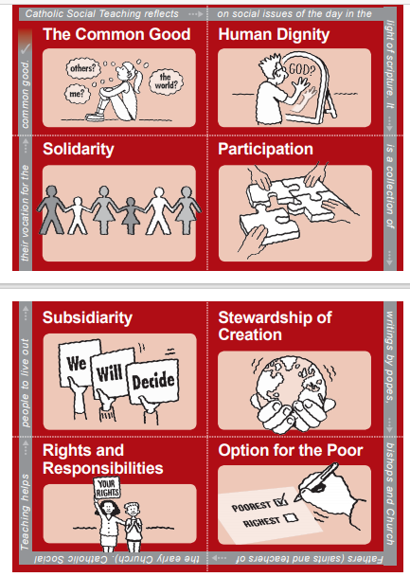
Values
A jigsaw:
Note the clue round the edge

Slide 6
The cards
The values mean …
Match the quotes to the value!
Notes:
First set are movie quotes. The second more detailed explanations

Slide 7
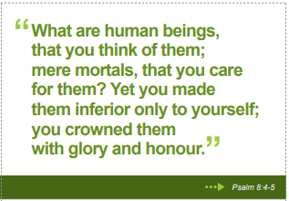
The cards
Scriptural quotes
Match the quote to the value!
Notes:
The use of Scripture can help to confirm the biblical source of the values which is helpful to some but may not work with others. Please use your discretion.

Slide 8
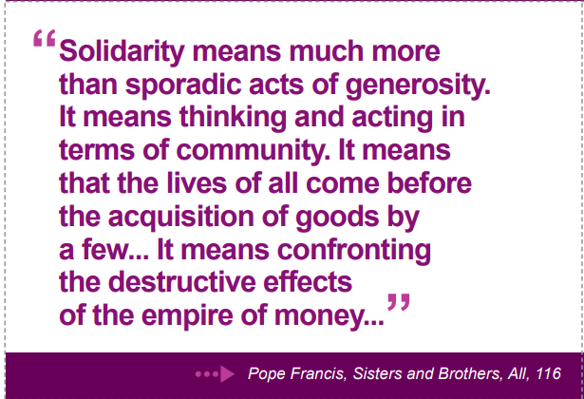
The cards
Catholic Social Teaching quotes
Match the quote to the value:
Notes:
The quote is from Fratelli Tutti, Pope Francis’ latest encyclical letter and part of Catholic Social Teaching. It focuses on the need for solidarity amongst all people and with the Earth. The phenomenon of climate change and global inequality are examples of how a lack of solidarity and respect for dignity and stewardship continues to cause real problems, which we can overcome if we can work together based on Catholic Social Teaching Values.

Slide 9
Reading the Signs of the Times:
CST in history
Notes:
Since 1891 and the first papal encyclical letter, Rerum Novarum, written by Pope Leo XIII, the Church has continued to challenge current conditions in the world and to encourage different responses to social issues based on interpretations of Scripture and fundamental values. This body of material has grown to be called Catholic Social Teaching.

Slide 10
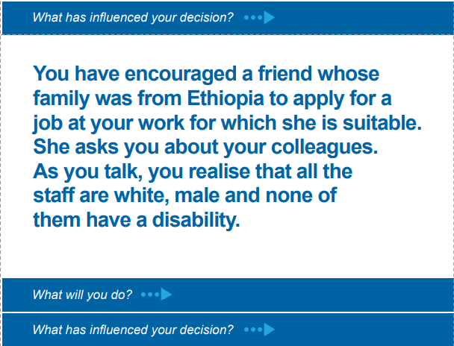
The cards
Scenarios (dilemmas):
Which value/s can you see in your response?
Notes:
There is a set of 8 cards to use to help people identify a sure value base in moral dilemmas for example. Catholic Social Teaching has a place throughout life, protecting the dignity of all and bringing the need to do this to the fore, often when we weren’t aware of a problem.

Slide 11
The cards
Real Stories
Notes:
CSAN has over 50 member agencies and these case studies are taken from the work of some of them. They are all examples of the Church putting the values into action in the modern world, something they do every day. The agencies need people’s support too. For more details, please see https://www.csan.org.uk/

Slide 12
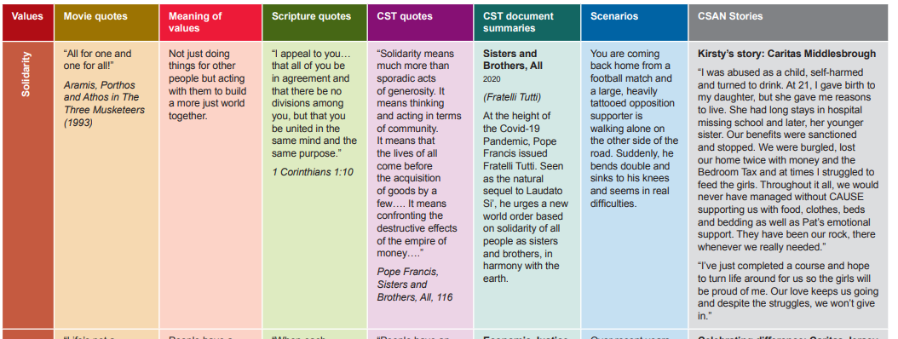
The cards
Leader’s notes
Notes:
The Guidance document, along with the cards, a promotional flier and a copy of this PowerPoint can be downloaded free at https://www.csan.org.uk/about-csan/publications/ under the Formation and Learning section.

Slide 13
The cards

Slide 14
The cards
Notes:
It is vital to understand that the cards are a tool to assist, not a course to get through. Use them flexibly so they can help, rather than glossing over lots of detail. One of their great strengths lies in sensitively helping people to share their motivations and confirming the CST values within a group. There are further suggestions of ideas for using the cards in the next two slides.
There are many other values in Catholic Social Teaching such as Hope, Compassion, the importance of the individual, community and family, etc.

Slide 15
Ideas
Very flexible to use e.g.
Jigsaw (building up complete picture)
Use one group only and build up the full set over time
Pick your favourite value – discuss
Early memories: find examples of a value/opposite from your childhood
Pick a value and find it in practice in your parish/work/family
Political issue? CST response would be …?
Time – and place (put and discuss CST docs in their historical context)
Cards provoke discussion in group: explore and norm positive behaviour
Values are all interlinked – the need to listen to people’s perceptions ….

Slide 16
Helpful questions for groups
Would you like to tell us why you have chosen that value in particular please?
You’ve chosen x (value). Can you remember the first time this came across as important to you please?
Does anyone else here feel strongly about x/this value?
Is there anyone in particular that personifies x/this value?
Which person locally/nationally/in the past/these days/internationally do you admire most?
What values are needed most in this parish/area to make the improvements we need?
Do you know anyone who has this/these values in particular?
Notes:
Questions to use in group settings

Slide 17
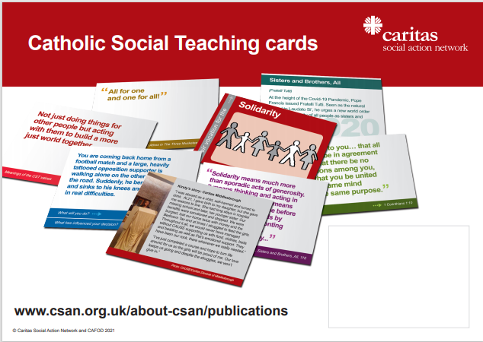
Promotional Flier
https://www.csan.org.uk/about-csan/publications/

Slide 18
Downloads
Altogether:
See “Catholic Social Teaching Card Pack”
Individually:
Cards
Guidance
Promotional flier
Notes:
Caritas in Practice is a new CSAN induction resource for staff and volunteers of all faiths and none

Slide 19
Thanks!
Ged Edwards
Network Development Officer
ged.edwards@csan.org.uk

