Slide 1
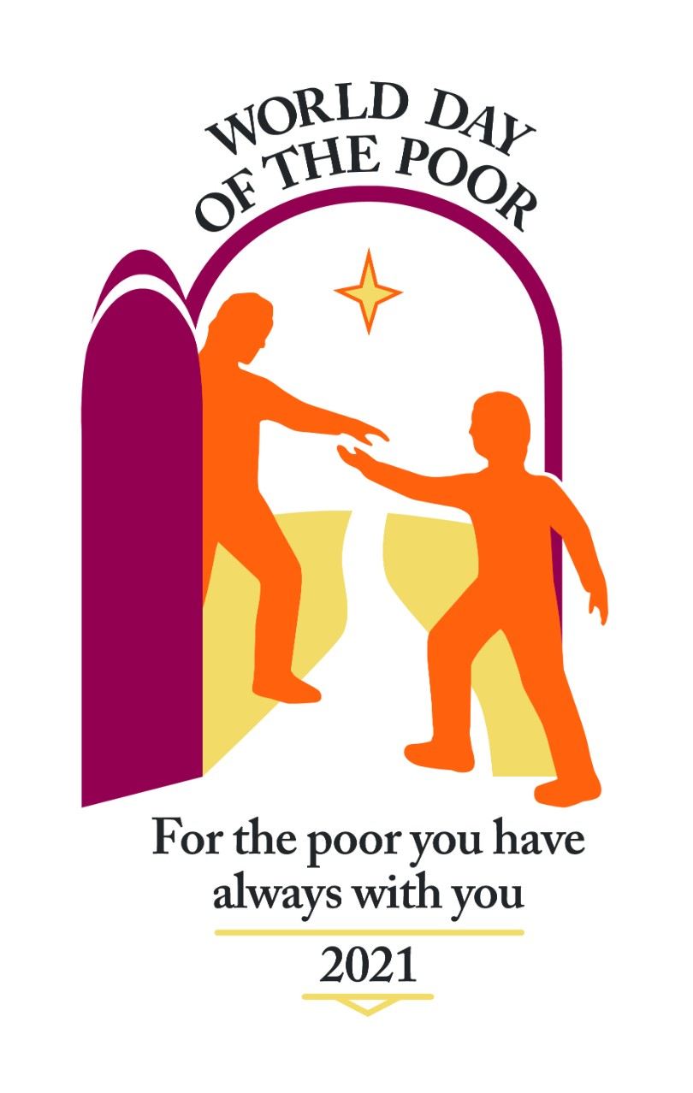

Slide 2
“What path of justice must be followed so that social inequalities can be overcome and human dignity, so often trampled upon, can be restored?”
Pope Francis, Message for World Day of the Poor, 2021

Slide 3
Opening Prayer
Lord, we come before you in all humility, mindful of our human weakness, sorry for the times we have ignored the needs of our brothers and sisters, when we have not been kind or helpful, when we crossed to the other side of the road, when we have given in to indifference.
Forgive us, Lord. Give us the grace to see the needs around us, the wisdom to choose the path of the Gospel and the courage to act as we should to build a better world.

Slide 4
Some BIG Questions
What does it mean to be poor?
How do some people end up being poor and some don’t?
What can we do about this?

Slide 5
The Widow’s Offering
A reading from the gospel of Mark (from 32nd Sunday in Ordinary Time, Year B)
“As he taught, he said, ‘Beware of the scribes, who like to walk around in long robes, and to be greeted with respect in the marketplaces, and to have the best seats in the synagogues and places of honour at banquets! They devour widows’ houses and for the sake of appearance say long prayers. They will receive the greater condemnation.”

Slide 6
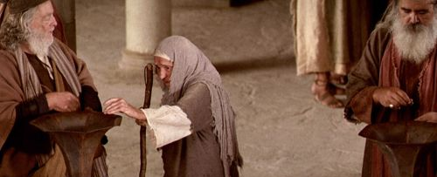
The Widow’s Offering
“He sat down opposite the treasury, and watched the crowd putting money into the treasury. Many rich people put in large sums. A poor widow came and put in two small copper coins, which are worth a penny. Then he called his disciples and said to them, “Truly I tell you, this poor widow has put in more than all those who are contributing to the treasury. For all of them have contributed out of their abundance; but she out of her poverty has put in everything she had, all she had to live on.”
Mark 12: 38-44

Slide 7
“They devour widows’ houses.”
“She has put in everything she had.”

Slide 8
Did you know?
In 2019, 2.4 million people in the UK, including 0.5 million children, experienced destitution at some point in the year, in other words they did not have enough to live on.
Before the Coronavirus pandemic, 14.5 million people in the UK were caught up in poverty, equating to 1 in 5 people.
About 9.2% of the world, or 689 million people, live in extreme poverty on less than $1.90 a day, according to the World Bank.
Today 258 million children – 1 out of every 5 – will not be allowed to go to school.
For every 100 boys of primary school age who are out of school, 121 girls are denied the right to education.
Notes:
Sources: Joseph Rowntree Foundation (https://www.jrf.org.uk/report/uk-poverty-2020-21), https://www.oxfam.org/en/5-shocking-facts-about-extreme-global-inequality-and-how-even-it

Slide 9
See
Judge
Act
Notes:
Community discernment – do you see you own parish – its relations – its structures – its inclusion, its formation, its racism or misogyny

Slide 10
SEE JUDGE ACT
SEE. What do you see in the photographs? Look closely. What moves you, angers you, gives you any hope? Why do you think what you see is like this?
JUDGE. What does the Gospel tell us about scenes like this? What would Jesus say about this? What is part of God’s plan and what is not?
ACT. What can we do about poverty, at home, in other countries? What difference can we make?

Slide 11
The following photographs, taken using a drone by the photographer Johnny Miller, have been used with permission.
For more information, please visit: https://unequalscenes.com/

Slide 12
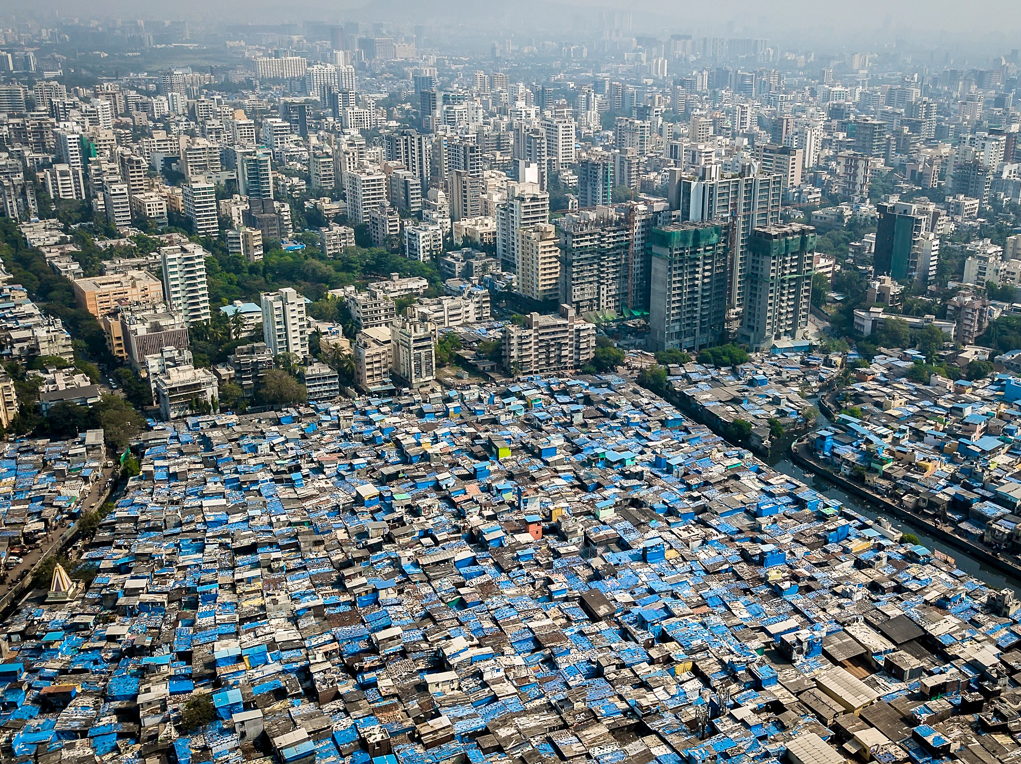

Slide 13
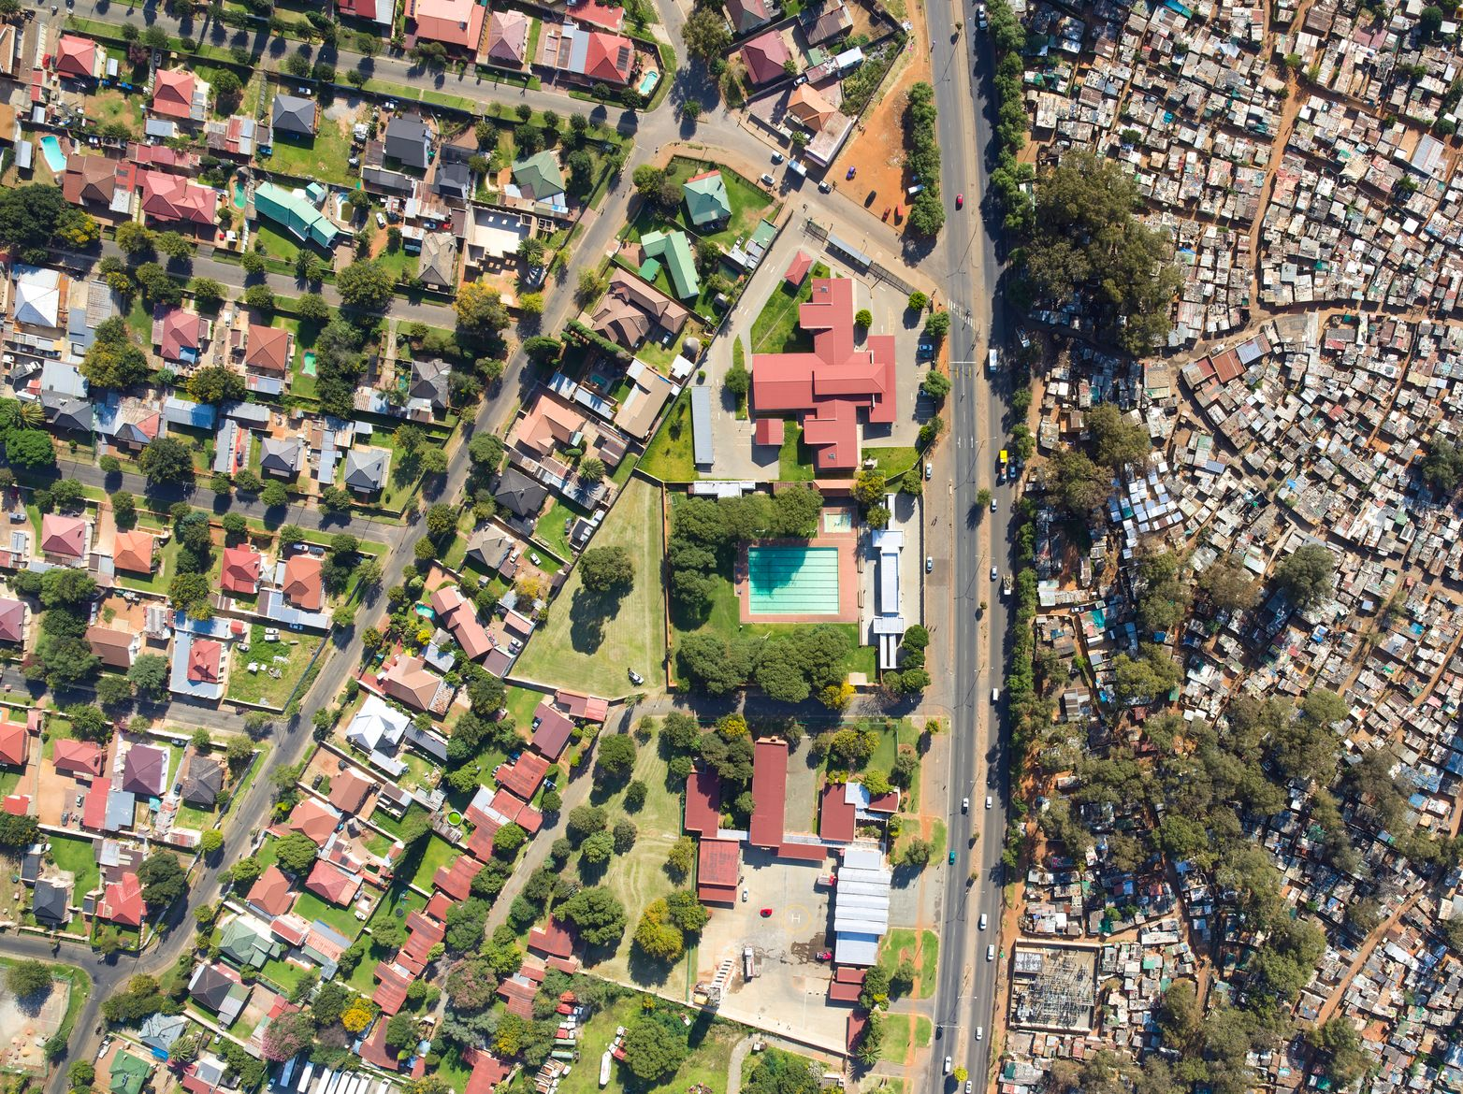

Slide 14
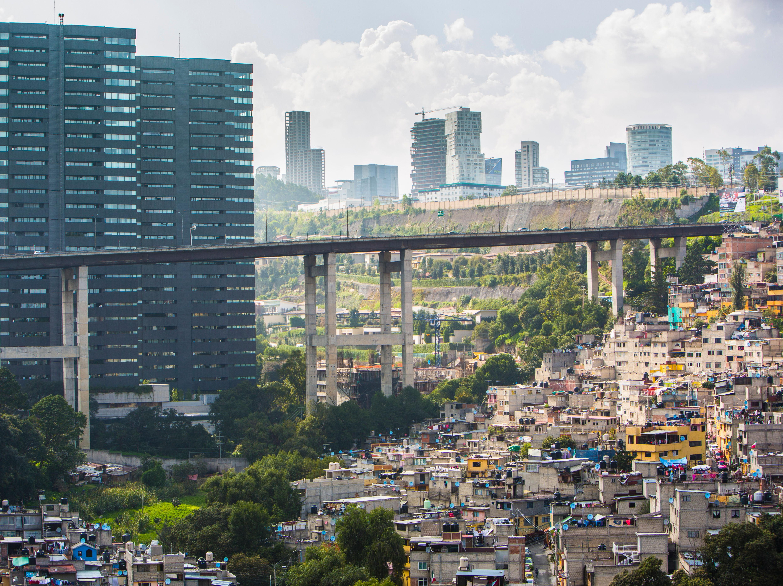

Slide 15
Bidding prayers
Lord, we pray for Pope Francis, that he may have the strength and courage to lead the Church and continue to be a voice for the voiceless, a friend to the poor. Lord in your mercy: hear our prayer.
Lord, we pray for our political leaders, that they will be motivated by compassion and justice so that their decisions contribute to the flourishing of those who are poor and vulnerable. Lord in your mercy: hear our prayer.

Slide 16
Lord, we pray for our school community, that we will always be kind and considerate and learn how to grow as agents of change who will build a better world. Lord in your mercy: hear our prayer.
Lord, we pray for our friends and families and anybody who needs our prayers at the moment. Lord in your mercy: hear our prayer.
We ask our mother Mary, the mother of God, to pray with us and for us as we say, Hail Mary…

Slide 17
